Slide 1

Robotics Programming Workshop1 (CSE 3197)​ End-Term Project Presentation on​ ESP32-CAM and OpenCV-Based Low-Cost Object Counting System for Real-Time Inventory and Resource Management​
Presented by
ASHUTOSH NAYAK ​
ASHUTOSH KUMAR HOTA​
SHUBHAM SATPATI ​
SUBHRANSHU KAR​
Supervisor
Dr. Biswaranjan Swain
Dr. Shaktijeet Mohapatra
Department of Computer Science Engineering (IOT)
Institute of Technical Education & Research (FET)
Siksha ‘O’ Anusandhan Deemed to be University, Bhubaneswar
December, 2024

Slide 2
Contents
Introduction
Literature Survey
Design Scheme
Testing, Analysis, And Evaluation
Protocols Used
Socio-economic Issues Associated With The Project
Engineering Tools And Standards
Troubleshooting Challenges
Conclusion

Slide 3
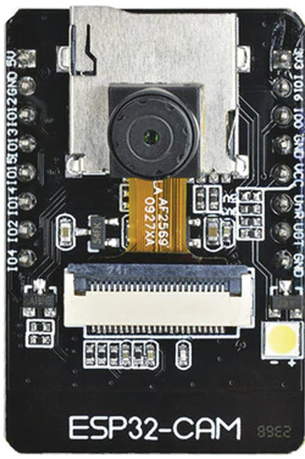
Introduction
Effective inventory and resource management is essential for minimizing losses, streamlining operations, and ensuring efficiency across industries and businesses. Accurate tracking systems are critical to maintaining smooth workflows, optimizing resource utilization, and supporting decision-making. Traditional inventory systems are often expensive, requiring specialized hardware and software that can be prohibitive for SMEs. The high costs create a barrier to entry. Still, embedded systems and open-source software advancements have enabled the development of affordable and accessible alternatives that meet modern needs. This presentation introduces a low-cost, real-time object-counting system using the ESP32-CAM microcontroller and OpenCV library. By leveraging cost-effective hardware and robust software, the system provides a scalable, efficient, and budget-friendly solution for modernizing inventory management processes while ensuring adaptability for diverse applications.

Slide 4
Literature Survey
The field of object counting and inventory management has witnessed significant advancements with the integration of computer vision and embedded systems. Previous studies have highlighted various methods and technologies used for object detection and counting in real-time applications.​
Object Counting Using Computer Vision: Traditional object counting systems rely on high-performance hardware and proprietary software, often utilizing machine learning algorithms like YOLO or SSD for object detection. ​
Embedded Systems in Computer Vision: Studies have explored the use of microcontrollers like Raspberry Pi and Arduino for cost-effective image processing. However, these systems often face limitations in computational power and real-time performance, necessitating the exploration of newer microcontrollers like ESP32-CAM.​
ESP32-CAM for Vision Applications: The ESP32-CAM microcontroller has gained attention for its affordability and built-in camera module. Research has demonstrated its potential in applications such as face detection, surveillance, and IoT-based monitoring systems.​

Slide 5
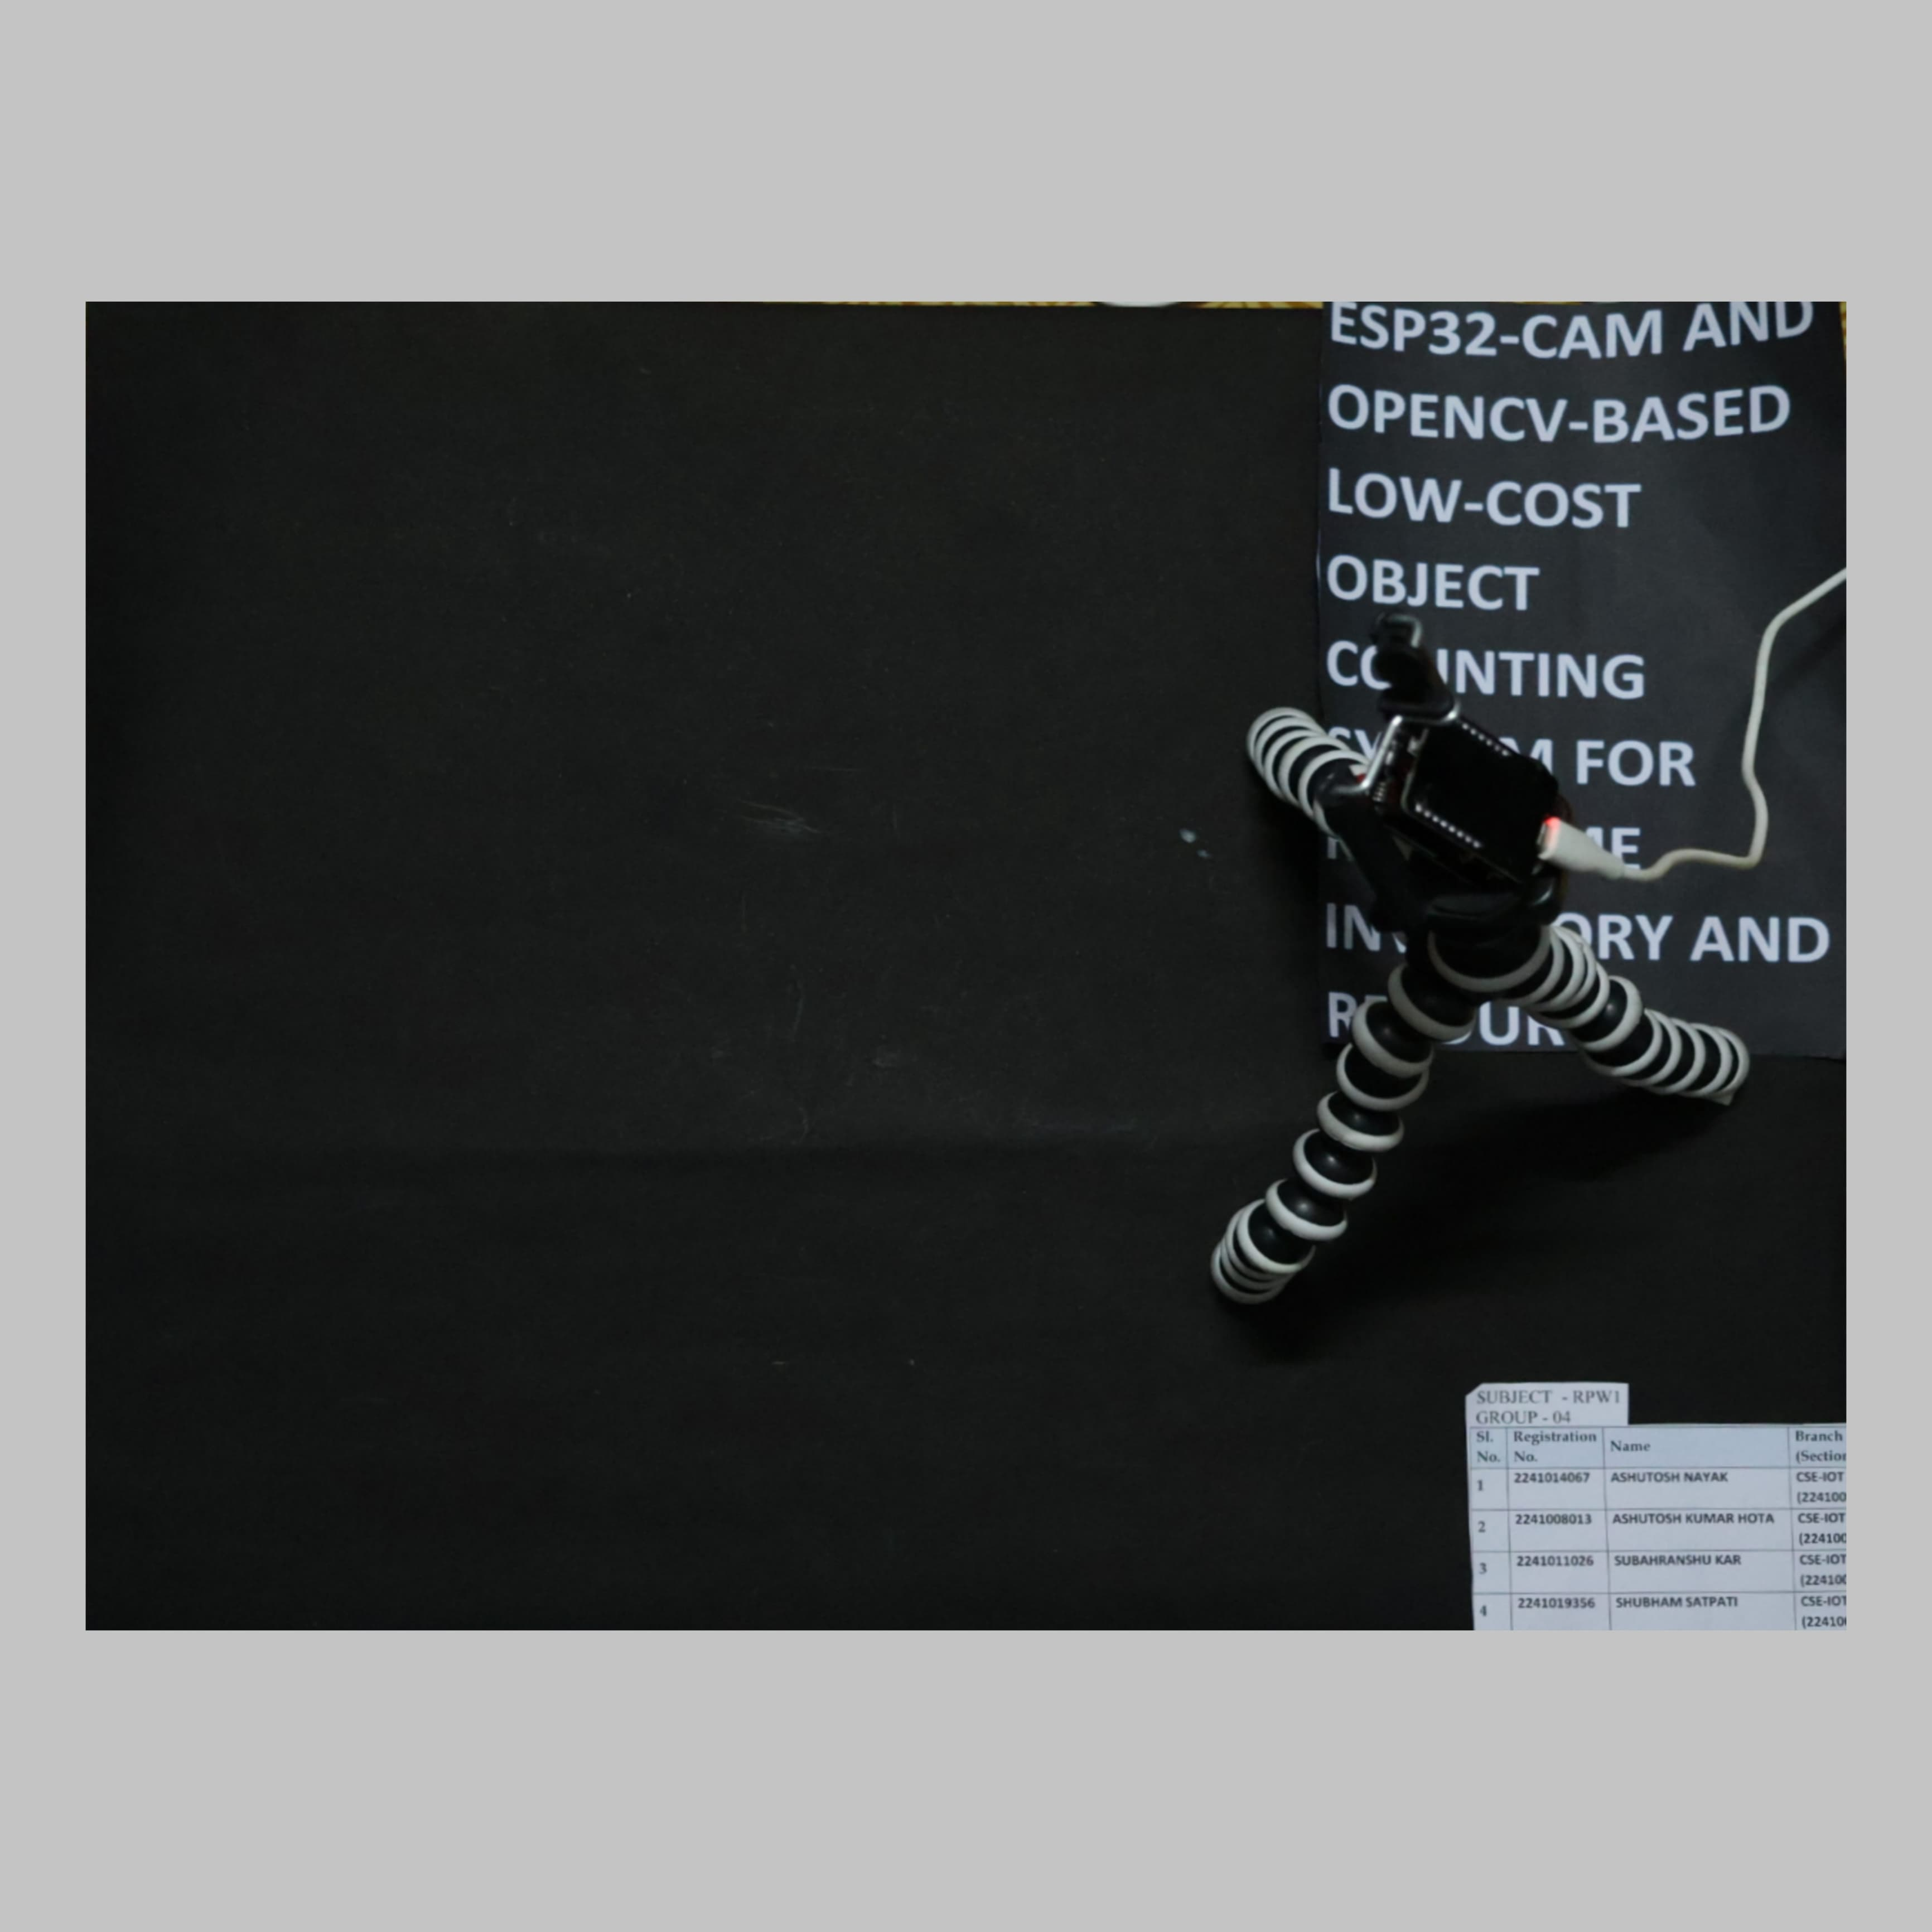
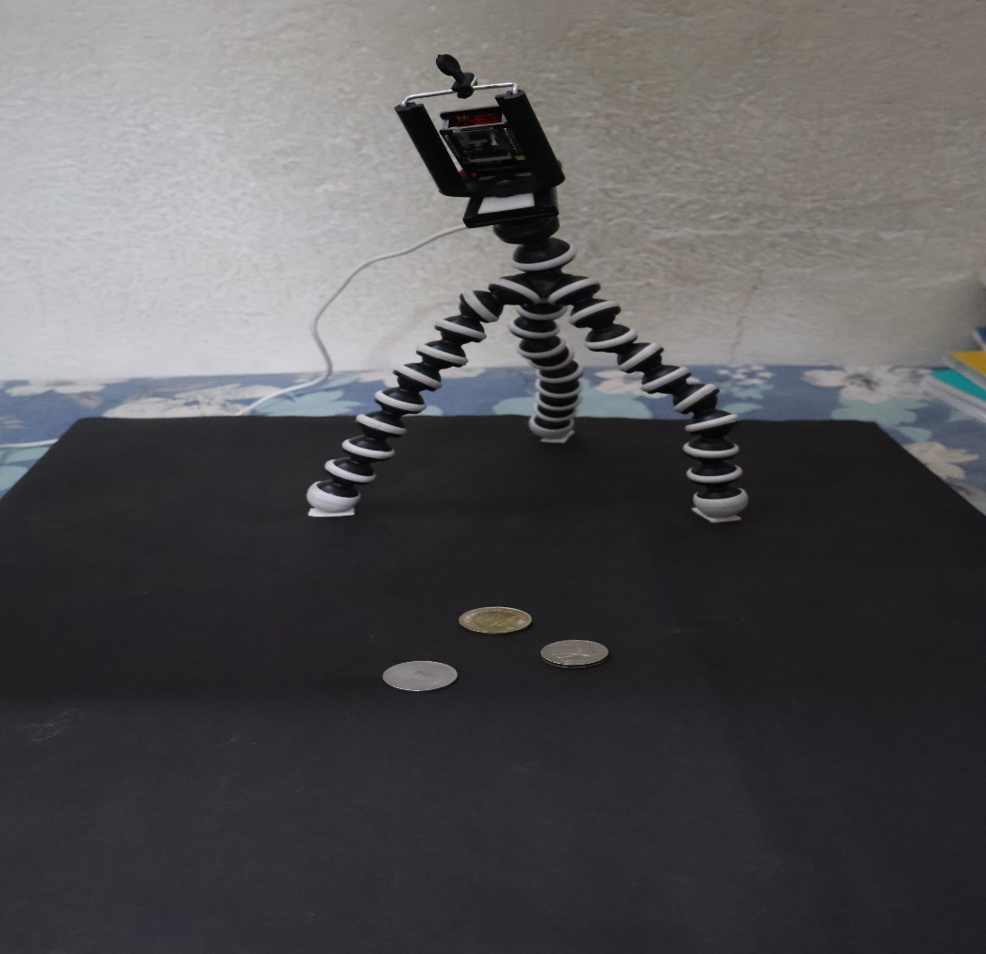
Design Scheme
The proposed​
TOP VIEW
FRONT VIEW

Slide 6
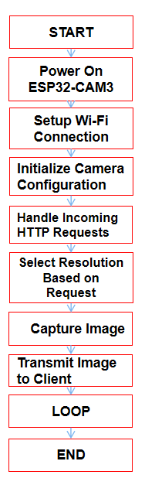
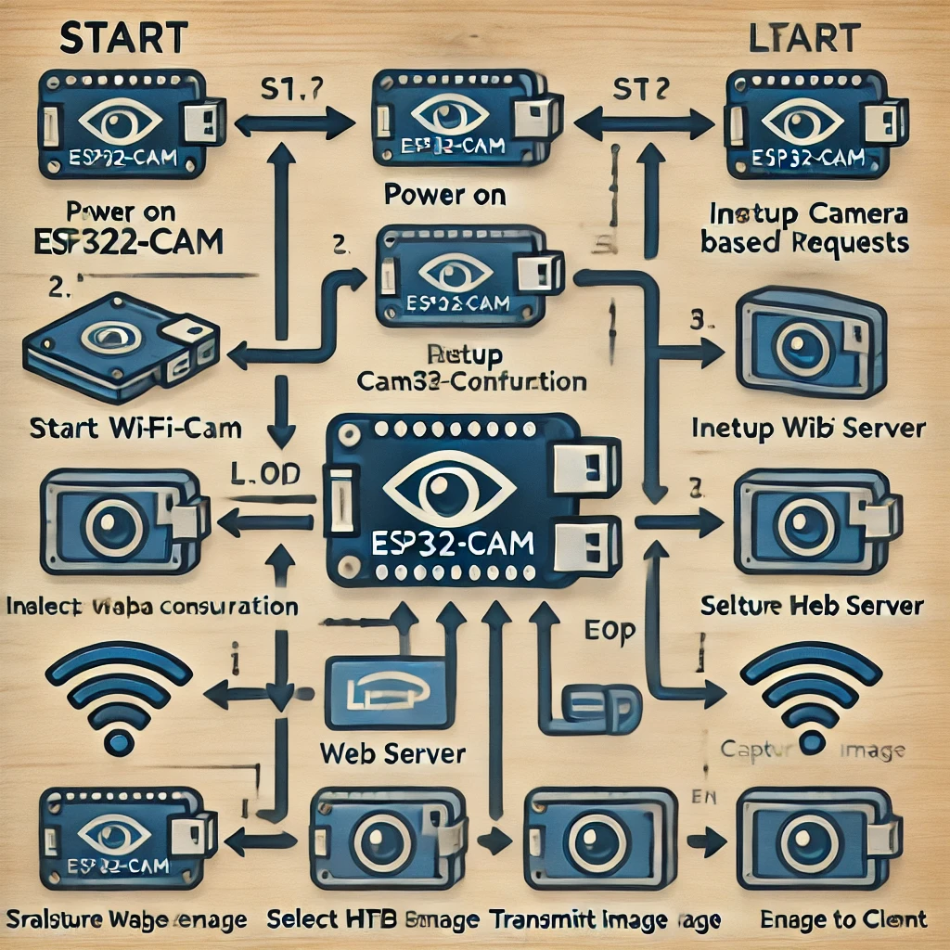
Design Scheme

Slide 7
Testing (Breadboard Implementation)
Testing:
Object Detection Accuracy: We have tested how accurately our system detects and counts objects in varying conditions (lighting, object shapes, and orientations).
Real-Time Processing: We have evaluated how fast the ESP32-CAM can capture and process images with OpenCV.
Network Performance: We have tested Wi-Fi connectivity and data transfer rate for real-time updates.
Analysis:
Accuracy vs. Cost: We have compared the object counting accuracy with traditional methods and evaluated the tradeoff with low-cost hardware.
Scalability: We have assessed the system's ability to scale for larger inventories or more objects.
Evaluation:
Reliability: We have tested the system under continuous operation to identify any issues such as hardware failure or software bugs.
User Feedback: We have collected feedback from real-world users (e.g., warehouse managers, inventory staff) to assess ease of use and functionality

Slide 8
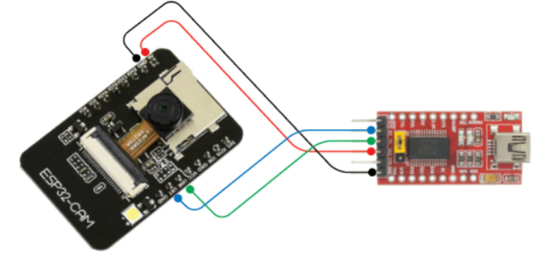
Testing (Breadboard Implementation)
Circuit Connections
1)ESP32-CAM Power:
Connect the VCC pin of the ESP32-CAM to the 5V rail of the breadboard.
Connect the GND pin to the ground rail of the breadboard.
2)FTDI Programmer:
Connect TX (FTDI) to U0R (ESP32-CAM).
Connect RX (FTDI) to U0T (ESP32-CAM).
Connect GND (FTDI) to the ground rail of the breadboard.
Use the FTDI programmer to upload the firmware/code.

Slide 9
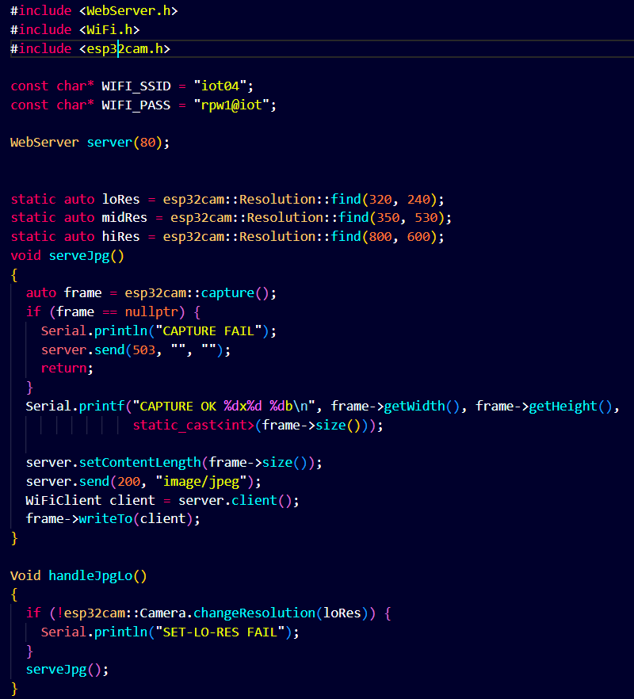
Testing (Code Implementation)

Slide 10
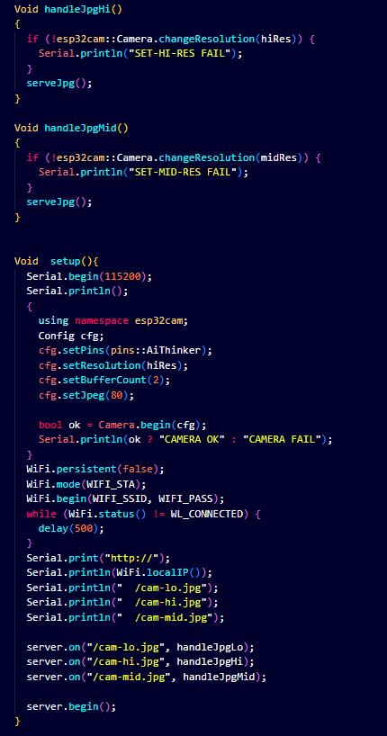

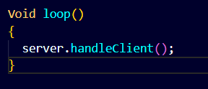
Testing (Code Implementation)

Slide 11
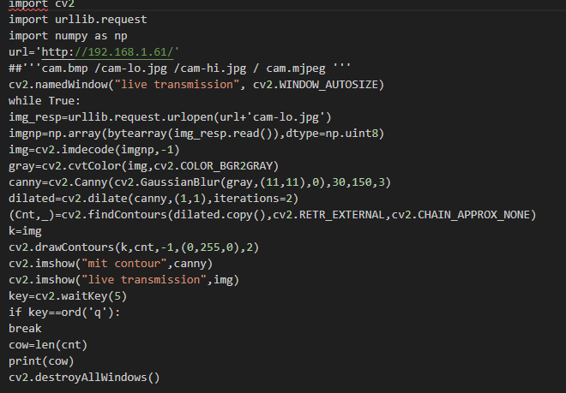
Testing (Code Implementation)

Slide 12
Protocol Used
HTTP is used for basic communication (image transmission from ESP32-CAM to the
server).
MJPEG facilitates the streaming of video for object counting in real time.
TCP/IP ensures reliable transmission of data between devices.

Slide 13
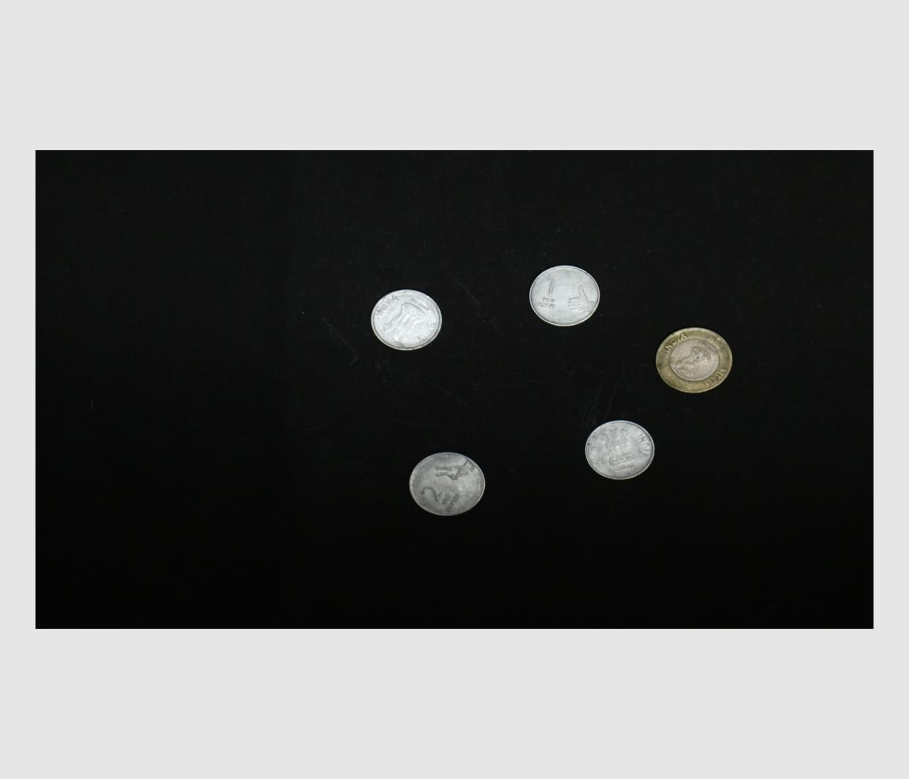
Results, Analysis and Evaluation
When the ESP32-CAM-based object counting system was tested with five different coins (one Rs 10 coin, one Rs 2 coin, and three Rs 1 coins), the system successfully detected all five objects in the frame. The OpenCV-based detection algorithm, which utilized contour detection and size filtering, was able to differentiate between the coins based on their dimensions. The system counted a total of five objects and displayed the count accurately.

Slide 14
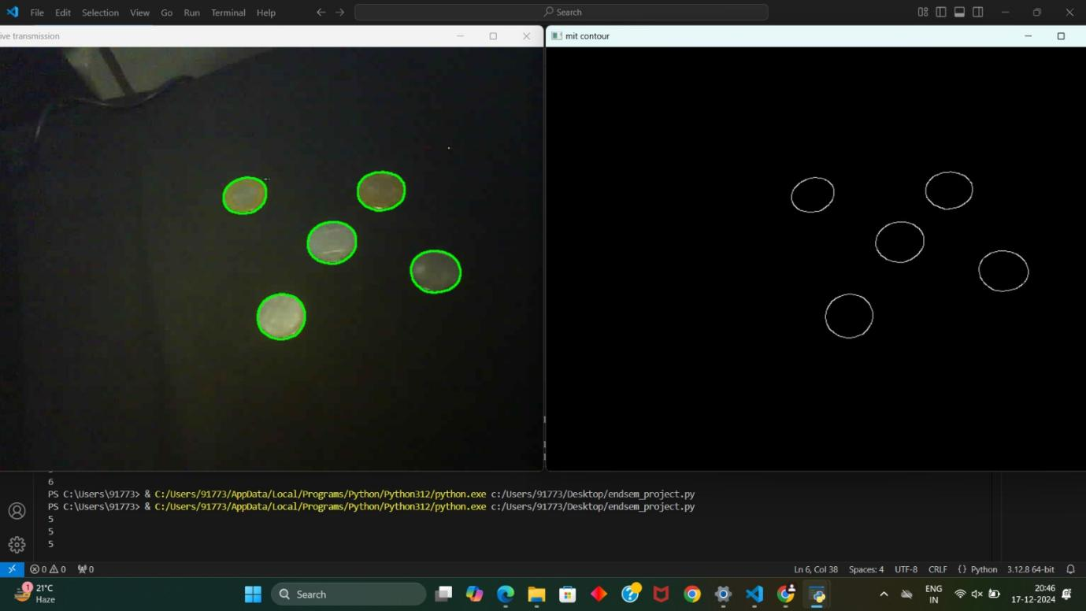
Results, Analysis and Evaluation
This output proves the successful detection of object by our project model.

Slide 15
Socio-economic Issues Associated With The Project
Accessibility for Small and Medium Enterprises (SMEs):​
The low cost of the system enables small businesses, startups, and local industries to adopt technology for inventory management, which was previously unaffordable due to high hardware and software costs.​
This democratization of technology levels the playing field for smaller businesses.​
Job Optimization:​
Automating object counting and inventory tracking reduces manual labor in repetitive tasks, allowing workers to focus on higher-value activities.​
It enhances operational efficiency, which could lead to increased profitability and competitiveness.​
Reduction in Operational Costs:​
By preventing inventory mismanagement and minimizing losses, businesses can save on operational expenses.​
Improved resource management can reduce waste and contribute to more sustainable practices.​
​

Slide 16
Engineering Tools And Standards
1. Hardware Tools:​
ESP32-CAM Module: Core microcontroller for image capture and processing.​
ESP32-CAM MB Driver: For programming and debugging the ESP32-CAM.​
Breadboard and Jumper Wires: For prototyping and testing.​
Power Supply Unit: To ensure consistent voltage for the ESP32-CAM and peripherals.​
2. Software Tools:​
Arduino IDE:​ Used for programming the ESP32-CAM and uploading firmware.​
Provides a user-friendly environment for embedded system development.​
OpenCV Library:​ Provides the algorithms for image processing and object detection.​
Includes tools for contour detection, edge detection, and template matching.​
Python/Embedded C/C++:​ Primary programming languages for developing the system’s software.​

Slide 17
Troubleshooting Challenges
We encountered several troubleshooting challenges during development and implementation. Here's a list of common issues
Low Camera Resolution or Poor Image Quality
Latency in Real-Time Processing
ESP32-CAM Power Supply Issues
Wi-Fi Connectivity Issues
Software or Library Compatibility Issues

Slide 18
Conclusion
The ESP32-CAM and OpenCV-based object counting system offers a cost-effective and efficient real-time inventory and resource management solution. By utilizing the ESP32-CAM module for image capture and OpenCV for object detection, the system provides a reliable and affordable alternative to traditional inventory tracking methods. The ESP32-CAM’s small form factor, low power consumption, and wireless capabilities make it suitable for various environments, including retail, warehouses, and manufacturing settings. OpenCV's image processing ensures accurate object counting even in lighting and cluttered scenes.
This system proves that even with limited hardware, it is possible to achieve effective and reliable inventory management. Future enhancements could include integrating more advanced machine learning models to improve detection accuracy and expanding the system to track additional data, such as object location or condition. Overall, this project demonstrates the potential of low-cost technology to streamline resource management and offers a scalable solution for businesses looking to optimize their inventory processes practically and affordably.

Slide 19
References
ESP32-CAM Documentation:​
Espressif Systems. "ESP32-CAM Datasheet."​
https://www.espressif.com/en/products/devkits/esp32-cam
OpenCV Library:​
OpenCV Development Team. "OpenCV Documentation."​
https://docs.opencv.org/
Arduino IDE:​
Arduino. "Arduino Integrated Development Environment."​
https://www.arduino.cc/en/software
ESP32 Programming Resources:​
Random Nerd Tutorials. "Getting Started with ESP32-CAM.“​
https://randomnerdtutorials.com/​
Object Detection with OpenCV:​
OpenCV Team. "Object Detection Using Contours and Thresholding."​
OpenCV documentation index
Reddit-Object Recognition on ESP32-CAM: https://www.reddit.com/r/esp32/comments/1at89yq/object_recognition_on_board_esp32cam/?utm_source=chatgpt.com

Slide 20


Slide 21


